Slide 1
CS 589 Fall 2021 Lecture 9
Encoder-decoder framework
Monday 6:30-9:00
Babbio 122
All zoom links in Canvas
Most slides adapted from Stanford CS224
photo: https://www.scubedstudios.com/information-retrieval/
Notes:
In this lecture, we will be talking about probabilistic ranking models, which is

Slide 2
Today’s lecture
Machine translation and attention mechanism
Transformer
Encoder representation network
Elmo
BERT
Notes:
we use Google playstore data as the data source, so we collect these data, we clean it, we split the sentence, and we build a filtering algorithm to select the high quality sentence

Slide 3
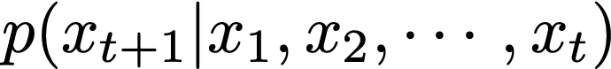
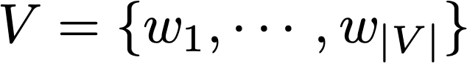
Review of language models
Language modeling is the task of predicting what word comes next
Given a sequence of words x1, x2, …, xt, compute the probability distribution for the next word xt+1
where xt+1 can be any word in the vocabulary
0.2
lamb
goat
0.3
mary has a little
bit
0.05
book
0.01
Notes:
we use Google playstore data as the data source, so we collect these data, we clean it, we split the sentence, and we build a filtering algorithm to select the high quality sentence

Slide 4
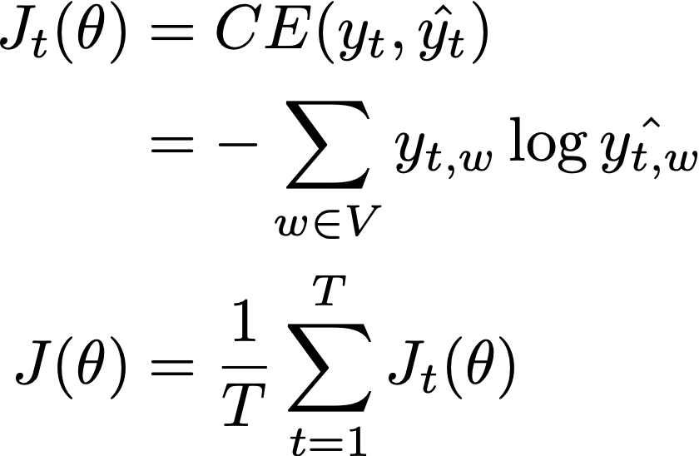
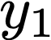
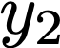
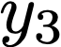
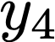
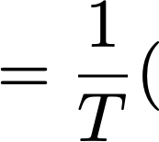
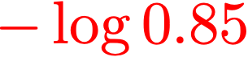
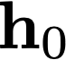
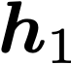
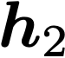
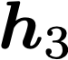
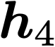
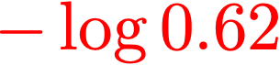
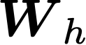
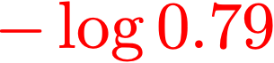
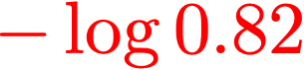
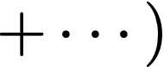
Training RNN method 1: Language modeling
Minimizes the cross entropy loss:
a
[0.79,
[0.09,
[0.01,
[0.09,
[0.79,
...
...
...
...
0.62,
0.62,
little
0.82,
0.01,
...
0.01,
0.82,
...
mary
0.85]
0.10]
0.10]
0.85]
0.10]
mary
has
a
little
Notes:
So The first method for training an RNN is language modeling.
Language modeling means we are training the model such that it tries to predict the next word. For example, we can use the cross entropy loss, where y_{t,w} are the ground truth and log_{hat{y_{t,w}}} are the predictions
So each y_{t,w} is the ground truth, which is a one hot vector, and these are the values of log_{hat{y_{t,w}}} which are the predictions for the probability of each word. So the cross entropy loss would be equal to this summation, for mary...
And the goal of the training is to train the weights W here so that this sum is minimized

Slide 5
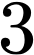
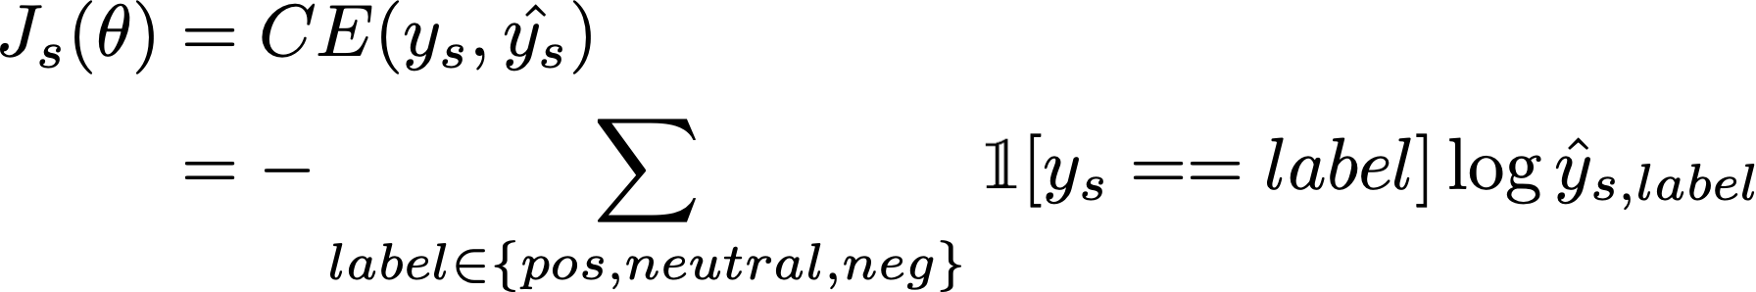

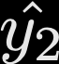

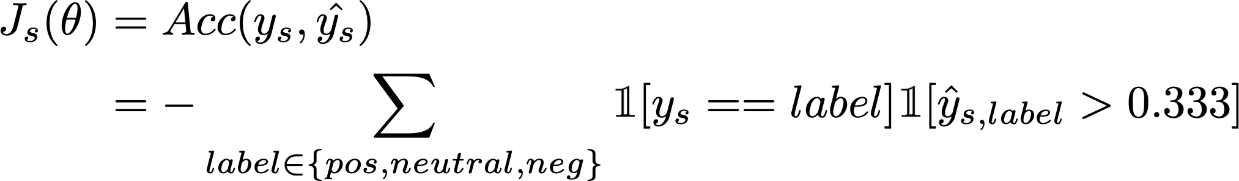
Training RNN method 2: Text classification
output distribution
pos
[0.2,
neutral
0.5,
Cross entropy loss (min):
neg
0.3]
Accuracy (max):
mary
has
a
little
Notes:
A SECOND method for training an RNN is text classification. For example, we can train the network for the sentiment analysis task. In this case, we are not using y1, y2, y3. Instead, for each sentence, we only use one of the output softmax, which is the last one y_4. We also adjust the size of this U such that the output yhat is a vector of size 3 instead of V. For each, sentence we compute *one* cross entropy loss.

Slide 6
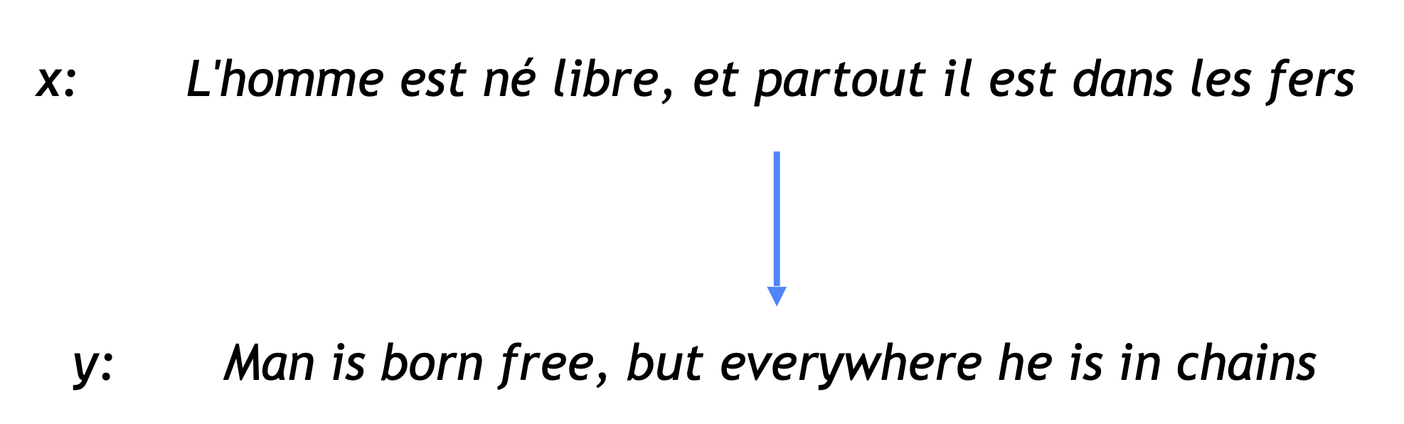
Machine translation
Translating a sentence from one language (source language) to another language (target language)
Notes:
we use Google playstore data as the data source, so we collect these data, we clean it, we split the sentence, and we build a filtering algorithm to select the high quality sentence

Slide 7
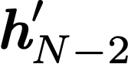
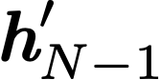
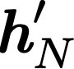
Training NN method 3: Machine Translation
Minimizes the cross entropy loss:
born
[0.79,
[0.09,
[0.01,
[0.09,
[0.79,
...
...
...
...
free
0.82,
0.01,
...
0.01,
0.82,
...
0.85,
0.85]
is
0.01]
0.62]
0.10]
0.10]
0.10]
(only output sentences)
dans
le
fers
man
is
born
free
Notes:
A SECOND method for training an RNN is text classification. For example, we can train the network for the sentiment analysis task. In this case, we are not using y1, y2, y3. Instead, for each sentence, we only use one of the output softmax, which is the last one y_4. We also adjust the size of this U such that the output yhat is a vector of size 3 instead of V. For each, sentence we compute *one* cross entropy loss.

Slide 8
Encoder-decoder framework
… dans les fers <START>
Notes:
we use Google playstore data as the data source, so we collect these data, we clean it, we split the sentence, and we build a filtering algorithm to select the high quality sentence

Slide 9
Encoder-decoder framework
man
… dans les fers <START> man
Notes:
we use Google playstore data as the data source, so we collect these data, we clean it, we split the sentence, and we build a filtering algorithm to select the high quality sentence

Slide 10
Encoder-decoder framework
man is
… dans les fers <START> man is
Notes:
we use Google playstore data as the data source, so we collect these data, we clean it, we split the sentence, and we build a filtering algorithm to select the high quality sentence

Slide 11
Encoder-decoder framework
hN' encodes the info of input French sentence
man is born free
… dans les fers <START> man is born ….
encoder RNN
decoder RNN
Notes:
we use Google playstore data as the data source, so we collect these data, we clean it, we split the sentence, and we build a filtering algorithm to select the high quality sentence

Slide 12
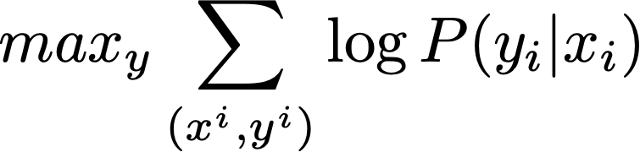
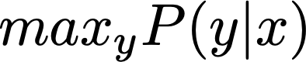
Training NN task 3: Neural machine translation
Translating a sentence from one language (source language) to another language (target language)
train:
similar training objective as language modeling
predict:
Notes:
we use Google playstore data as the data source, so we collect these data, we clean it, we split the sentence, and we build a filtering algorithm to select the high quality sentence

Slide 13
Encoder-decoder framework: Other applications
What does SIT stand for?
Stevens Institute of Technology
machine translation
factoid question answering
Open the file file.txt and read it line by line
Can you show me the ticket from NY to LA?
with open('file.txt', 'r') as fin:
lines = fin.readlines()
OK, what are the dates of your flight?
natural language to code
conversational agent
Notes:
A SECOND method for training an RNN is text classification. For example, we can train the network for the sentiment analysis task. In this case, we are not using y1, y2, y3. Instead, for each sentence, we only use one of the output softmax, which is the last one y_4. We also adjust the size of this U such that the output yhat is a vector of size 3 instead of V. For each, sentence we compute *one* cross entropy loss.

Slide 14
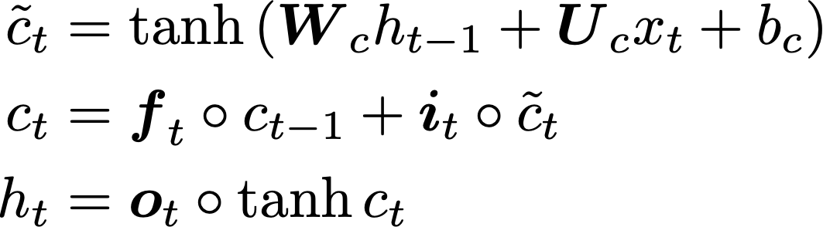
Encoder (Input Network)
hN' encodes the info of input French sentence
LSTM encoder:
Other encoders:
GRU
LSTM/GRU + attention
Elmo
BERT
…
… dans les fers
encoder RNN
Notes:
we use Google playstore data as the data source, so we collect these data, we clean it, we split the sentence, and we build a filtering algorithm to select the high quality sentence

Slide 15
Decoder (Output network)
Decoder selects the word to generate in the target sentence
Decoder framework can be different from encoder framework
Training:
Train by objective on decoder
Prediction:
Predict the output sequence using the decoder
man is born free
<START> man is born ….
decoder RNN
Notes:
we use Google playstore data as the data source, so we collect these data, we clean it, we split the sentence, and we build a filtering algorithm to select the high quality sentence

Slide 16
Decoding (Prediction)
Greedy decoding
Disadvantage of greedy decoding: cannot undo decisions
Exhaustive search? exponential search space
man is born free
<START> man is born ….
decoder RNN
Notes:
we use Google playstore data as the data source, so we collect these data, we clean it, we split the sentence, and we build a filtering algorithm to select the high quality sentence

Slide 17
Beam search decoding
A trade-off between greedy decoding + exhaustive search
In each step of the decoder, keep track of the k most probable partial translations (hypotheses)
he
I
<START>
…
Notes:
we use Google playstore data as the data source, so we collect these data, we clean it, we split the sentence, and we build a filtering algorithm to select the high quality sentence

Slide 18
Beam search decoding
A trade-off between greedy decoding + exhaustive search
In each step of the decoder, keep track of the k most probable partial translations (hypotheses)
hit
he
struck
<START>
was
I
got
Notes:
we use Google playstore data as the data source, so we collect these data, we clean it, we split the sentence, and we build a filtering algorithm to select the high quality sentence

Slide 19
Beam search decoding
A trade-off between greedy decoding + exhaustive search
In each step of the decoder, keep track of the k most probable partial translations (hypotheses)
hit
he
struck
<START>
was
I
got
Notes:
we use Google playstore data as the data source, so we collect these data, we clean it, we split the sentence, and we build a filtering algorithm to select the high quality sentence

Slide 20
Beam search decoding
A trade-off between greedy decoding + exhaustive search
In each step of the decoder, keep track of the k most probable partial translations (hypotheses)
hit
he
struck
<START>
was
I
got
Notes:
we use Google playstore data as the data source, so we collect these data, we clean it, we split the sentence, and we build a filtering algorithm to select the high quality sentence

Slide 21
Decoding: How do we know when to stop?
When do we stop the generation?
Append an <END> token to every target sentence in the training data
Train the model, so it knows when to predict <END>
During decoding, stop a hypothesis if <END> is predicted
We continue beam search util
We reach time step T, or
We have at least n completed hypotheses
Notes:
we use Google playstore data as the data source, so we collect these data, we clean it, we split the sentence, and we build a filtering algorithm to select the high quality sentence

Slide 22
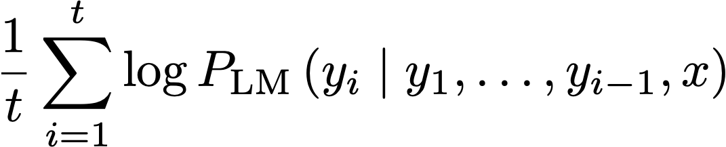
Beam search decoding: Selecting output hypothesis
Each hypothesis has a log probability score
Longer hypothesis always have lower scores
Solution: normalize hypotheses by length
Notes:
we use Google playstore data as the data source, so we collect these data, we clean it, we split the sentence, and we build a filtering algorithm to select the high quality sentence

Slide 23
Machine translation timeline
Statistical machine translation:
IBM model 1-5 [Brown et al. 1993]
2014: first seq2seq paper was published
2016: Google Translate switched from SMT to NMT
The SMT system, built by hundreds of engineers over many years, outperformed by the NMT systems trained by a handful of engineers in a few months
Notes:
we use Google playstore data as the data source, so we collect these data, we clean it, we split the sentence, and we build a filtering algorithm to select the high quality sentence

Slide 24
Evaluating machine translation
How to evaluate the correctness of a translated sentence?
Compare the similarity between the prediction and the ground truth
Capturing the similarity beyond unigram matching
BLEU (Bilingual Evaluation Understudy)
BLEU compares the machine-written translation to one or several human-written translation(s), and computes a similarity score based on:
n-gram precision (usually for 1, 2, 3 and 4-grams)
a penalty for too-short system translations
BLEU is useful but imperfect (non-overlapping ngrams)
Notes:
we use Google playstore data as the data source, so we collect these data, we clean it, we split the sentence, and we build a filtering algorithm to select the high quality sentence

Slide 25
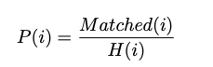
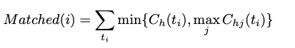
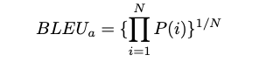
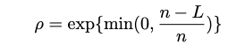
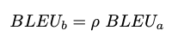
BLEU score
Step 1: computing the percentage of the i-gram tuples in the hypothesis that also occur in the references
Step 2: averaging over the percentages:
Penalizing short translations:
#times t_i occurs in the hypothesis h
#times t_i occurs in the j-th reference for hypothesis h
n: length of hypothesis
L: length of reference
Notes:
we use Google playstore data as the data source, so we collect these data, we clean it, we split the sentence, and we build a filtering algorithm to select the high quality sentence

Slide 26
CS 589 Fall 2021 Lecture 9
Attention mechanism
Monday 6:30-9:00
Babbio 122
All zoom links in Canvas
Most slides adapted from Stanford CS224
photo: https://www.scubedstudios.com/information-retrieval/
Notes:
In this lecture, we will be talking about probabilistic ranking models, which is

Slide 27
Attention mechanism
Training the neural network to attend to the most relevant input to the next word to predict
?
Notes:
we use Google playstore data as the data source, so we collect these data, we clean it, we split the sentence, and we build a filtering algorithm to select the high quality sentence

Slide 28
Attention mechanism
Attention mechanism is designed for each word to focus on one or a just a few words in the source sentences
attention
dot product [Luong et al. 2015];
RNNSearch [Bahdanau et al. 2014]
encoder
… est dans les <START>
Notes:
we use Google playstore data as the data source, so we collect these data, we clean it, we split the sentence, and we build a filtering algorithm to select the high quality sentence

Slide 29
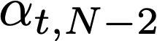
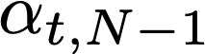
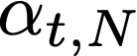
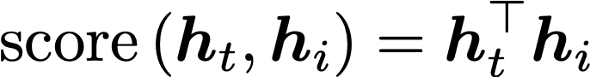
Attention mechanism: Dot-product attention
[Luong et al. 2015]
Step 1: Getting the attention weight
Using the hidden vector to compute the attention weight
weight
attention
encoder
Notes:
we use Google playstore data as the data source, so we collect these data, we clean it, we split the sentence, and we build a filtering algorithm to select the high quality sentence

Slide 30
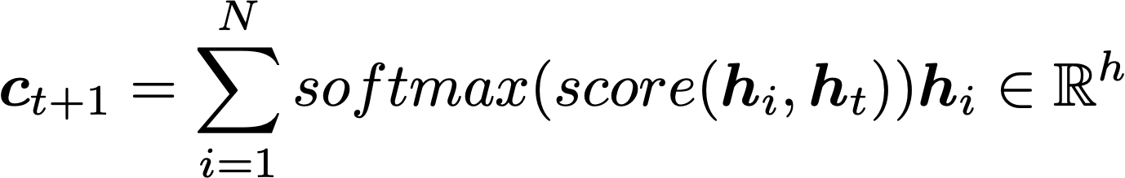
Attention mechanism: Dot-product attention
[Luong et al. 2015]
Step 2: Computing the memory vector ct using the integration of the hidden vector
weight
Notes:
we use Google playstore data as the data source, so we collect these data, we clean it, we split the sentence, and we build a filtering algorithm to select the high quality sentence

Slide 31
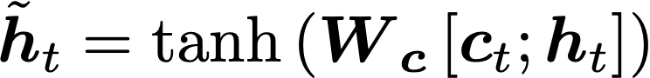
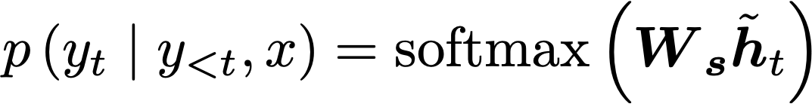
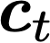
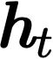
Attention mechanism: Dot-product attention
[Luong et al. 2015]
Step 3: Using the combination of memory vector ct and hidden vector for prediction
Step 1-2
Notes:
we use Google playstore data as the data source, so we collect these data, we clean it, we split the sentence, and we build a filtering algorithm to select the high quality sentence

Slide 32
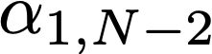
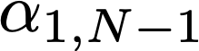
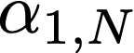
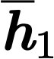
Attention mechanism: RNNSearch
[Bahdanau et al. 2014]
weight
attention
GRU
encoder
Notes:
we use Google playstore data as the data source, so we collect these data, we clean it, we split the sentence, and we build a filtering algorithm to select the high quality sentence

Slide 33
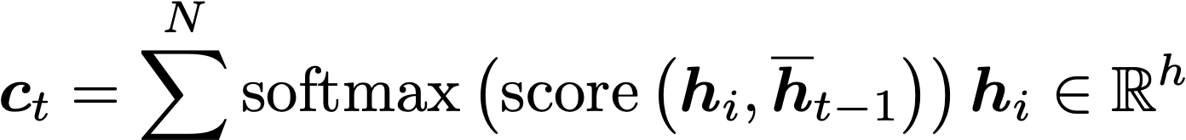
Attention mechanism: RNNSearch
[Bahdanau et al. 2014]
weight
Notes:
we use Google playstore data as the data source, so we collect these data, we clean it, we split the sentence, and we build a filtering algorithm to select the high quality sentence

Slide 34


Attention mechanism: RNNSearch
[Bahdanau et al. 2014]
Step 1-2
GRU
Notes:
we use Google playstore data as the data source, so we collect these data, we clean it, we split the sentence, and we build a filtering algorithm to select the high quality sentence

Slide 35

Attention mechanism: RNNSearch
[Bahdanau et al. 2014]
output
Step 1-2
Notes:
we use Google playstore data as the data source, so we collect these data, we clean it, we split the sentence, and we build a filtering algorithm to select the high quality sentence

Slide 36


Attention mechanism: Dot-product attention vs RNNSearch
For t = 1,…, T:
For t = 1,…, T:
dot product attention
RNN search attention
Notes:
we use Google playstore data as the data source, so we collect these data, we clean it, we split the sentence, and we build a filtering algorithm to select the high quality sentence

Slide 37

Comparing attention with LSTM
Step 1-2
Notes:
we use Google playstore data as the data source, so we collect these data, we clean it, we split the sentence, and we build a filtering algorithm to select the high quality sentence

Slide 38

Performance of attention [Luong et al. 2015]
Notes:
we use Google playstore data as the data source, so we collect these data, we clean it, we split the sentence, and we build a filtering algorithm to select the high quality sentence

Slide 39









Pre-trained word embeddings
In RNN, we randomly initialize the weight, use the back propagation to update this weight
The random initialization may not give us a good starting point
We can choose a better starting point with embedding vectors pertained in a large unlabelled corpus to help the initialization [Mikolov et al. 13]
mary
has
a
little
Notes:
we use Google playstore data as the data source, so we collect these data, we clean it, we split the sentence, and we build a filtering algorithm to select the high quality sentence

Slide 40
From pretrained embedding to pretrained encoder
Pretrained embeddings: fixed vectors
Pretrained encoder representation:
Neural network layers which takes an input sentence and encodes it into a layer output to be fed into another network, the encoder representation can be fine tuned
A pretrained LSTM on auto encoder & next word prediction can be used as a starting point to improve the performance of downstream supervised LSTM tasks [Dai & Le 2015]
ELMo [Peters et al. 2018]
Notes:
we use Google playstore data as the data source, so we collect these data, we clean it, we split the sentence, and we build a filtering algorithm to select the high quality sentence

Slide 41

ELMo [Peters et al. 2018]
Train an L-layered bidirectional LSTM model, i.e., predicting the next word & the previous word
Collapse all the 2L+1 representations into a single layer
Concatenate the ELMo weights into task specific models
Concatenate with input
Concatenate with output
Notes:
we use Google playstore data as the data source, so we collect these data, we clean it, we split the sentence, and we build a filtering algorithm to select the high quality sentence

Slide 42
Transformer [2017]
Non-recurrent sequence to sequence encoder-decoder model
Encoder and decoder architectures
Multi-head self attention [Lin et al. 2017]
Position encoding [Gehring et al. 2017]
Notes:
we use Google playstore data as the data source, so we collect these data, we clean it, we split the sentence, and we build a filtering algorithm to select the high quality sentence

Slide 43
Encoder/decoder in transformer
Encoder: 6 identical layers
First layer: multi-head self attention
Second layer: fully connected feed forward network, followed by layer normalization
Decoder: 6 identical layers
First & second: multi-head self attention
Third layer: fully connected feed forward
Notes:
we use Google playstore data as the data source, so we collect these data, we clean it, we split the sentence, and we build a filtering algorithm to select the high quality sentence

Slide 44
Self attention
[Lin et al. 2017]
What do we mean by self attention?
In dot-product attention, target attends to source only
Source shall never attend to target (why?)
In self attention, target can attend to source, source itself can also attend to source, target can also attend to target, so called internal attention
source: https://pretteyandnerdy.wordpress.com/2019/04/26/attention-is-all-you-need/
Notes:
we use Google playstore data as the data source, so we collect these data, we clean it, we split the sentence, and we build a filtering algorithm to select the high quality sentence

Slide 45

Self attention
[Lin et al. 2017]
Step 1: Computing the self attention weights
The vector at each position is replicated as 3 vectors: Q, K, V vectors
Computing alpha is fast because it can be done using matrix multiplication (whose complexity is O(n^2.37) as of 2020)
Notes:
https://stats.stackexchange.com/questions/421935/what-exactly-are-keys-queries-and-values-in-attention-mechanisms

Slide 46

Self attention [Lin et al. 2017]
Step 2: computing the context vector
Notes:
we use Google playstore data as the data source, so we collect these data, we clean it, we split the sentence, and we build a filtering algorithm to select the high quality sentence

Slide 47

Self attention
[Lin et al. 2017]
Step 2: Computing the context vector ct which will be used for prediction
c1 c2 c3 c4
LSC is the best
Notes:
we use Google playstore data as the data source, so we collect these data, we clean it, we split the sentence, and we build a filtering algorithm to select the high quality sentence

Slide 48
Attention vs. Self Attention
Attention is often applied to RNN, whereas self attention does not require RNN (i.e., attention is all you need)
Attention happens from decoder -> encoder, self attention also looks from encoder to encoder state, and from decoder state to decoder state
Self attention time cost increase quadratically with the sequence length
Notes:
we use Google playstore data as the data source, so we collect these data, we clean it, we split the sentence, and we build a filtering algorithm to select the high quality sentence

Slide 49


Position embedding
So far we have not considered the order between words
Word orders are important for encoding sentence semantics
How to solve the problem? Position embedding
For example, with 4-dimensional embedding, dmodel = 6:
Notes:
we use Google playstore data as the data source, so we collect these data, we clean it, we split the sentence, and we build a filtering algorithm to select the high quality sentence

Slide 50
Competition of pretrained language models
source: https://www.microsoft.com/en-us/research/blog/turing-nlg-a-17-billion-parameter-language-model-by-microsoft/
Notes:
we use Google playstore data as the data source, so we collect these data, we clean it, we split the sentence, and we build a filtering algorithm to select the high quality sentence

Slide 51
BERT: Bidirectional Encoder Representations
Pre-training BERT
Task #1: Masked LM
Mask out k% input words
Predict the masked words given all its context (“cloze” style)
Enables representation to fuse the left and right context

Slide 52
BERT: Bidirectional Encoder Representations
Pre-training BERT
Task #1: Masked LM
Problem: pre-training and fine-tuning mismatch
[MASK] will never appear in downstream task training
Solution: not always use [MASK]
80% use [MASK]
10% use a random token
10% use the original token

Slide 53
BERT: Bidirectional Encoder Representations
Pre-training BERT
Task #1: Masked LM
Task #2: Next Sentence Prediction (NSP)
Predict whether B is the actual sentence that proceeds A (True / False)
To learn relationship between sentences

Slide 54
BERT: Bidirectional Encoder Representations
Pre-training BERT
Input: unlabeled sentence pair
Training
Masked LM
NSP (label position [CLS])

Slide 55
BERT: Bidirectional Encoder Representations
Fine-tuning BERT

Slide 56


BERT experimental results

Slide 57

Effects of pretraining tasks
Masked LM (compared to left-to-right LM) is very important on some tasks, Next Sentence Prediction is important on other tasks
Left-to-right model does very poorly on word-level task (SQuAD), although this is mitigated by BiLSTM

Slide 58

Effects of dimensionality and training time
Masked LM takes slightly longer to converge because we only predict 15% instead of 100%
But absolute results are much better almost immediately

Slide 59

Effects of dimensionality and training time
Big models help a lot
Going from 110M -> 340M params helps even on datasets with 3,600 labeled examples
Improvements have not asymptoted

Slide 60

BERT: Open source release
One reason for BERT’s success was the open source release
Minimum dependency
Abstracted so people could including a single file to use model
Thorough README
Idiomatic code
Well-documented code
Good support (for the first few months)
from transformers import AutoTokenizer, AutoModelForMaskedLM
tokenizer = AutoTokenizer.from_pretrained("bert-base-uncased")
model = AutoModelForMaskedLM.from_pretrained("bert-base-uncased")

Slide 61


Homework 4
Using Google colab to train a text classification model
Supports keras, tensor flow and pytorch
Free Tesla K80 GPU
Homework 4: StackOverflow programming language prediction using hugging face’s transformer library

